Slide 1

Brain TAMP – 3D
Team Members:
Mohammad Hasnain
Sajjad Ali
Mujeeb Ahmed
Supervised by:
Dr. Ahsanullah Abro

Slide 2










Outline
Introduction & Background
Problem Statement
Proposed Solution
Objectives
Literature Review
Methodology
Expected Results
Scope of the project
Gantt Chart
Work Division

Slide 3
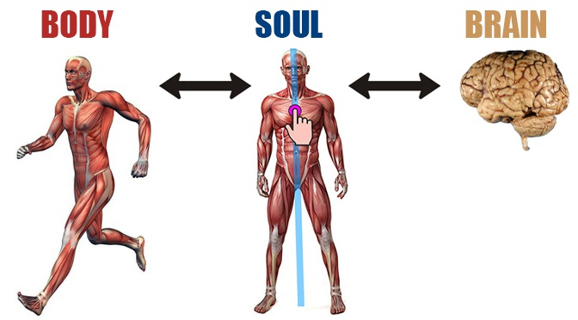
Introduction & Background

Slide 4
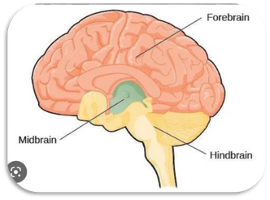

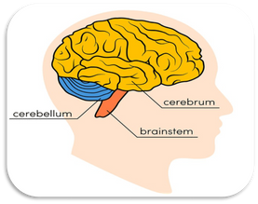
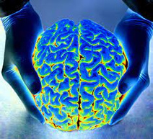
Introduction & Background
The human brain is studied by considering its four perspectives
Taxonomy
Physiology
Anatomy
Morphology

Slide 5
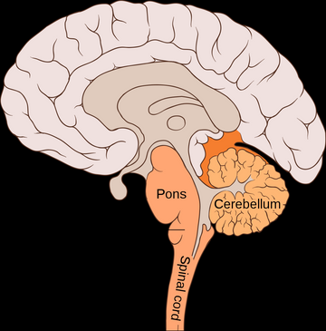
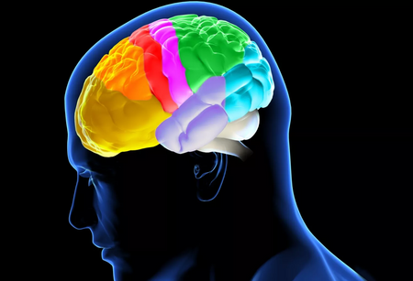
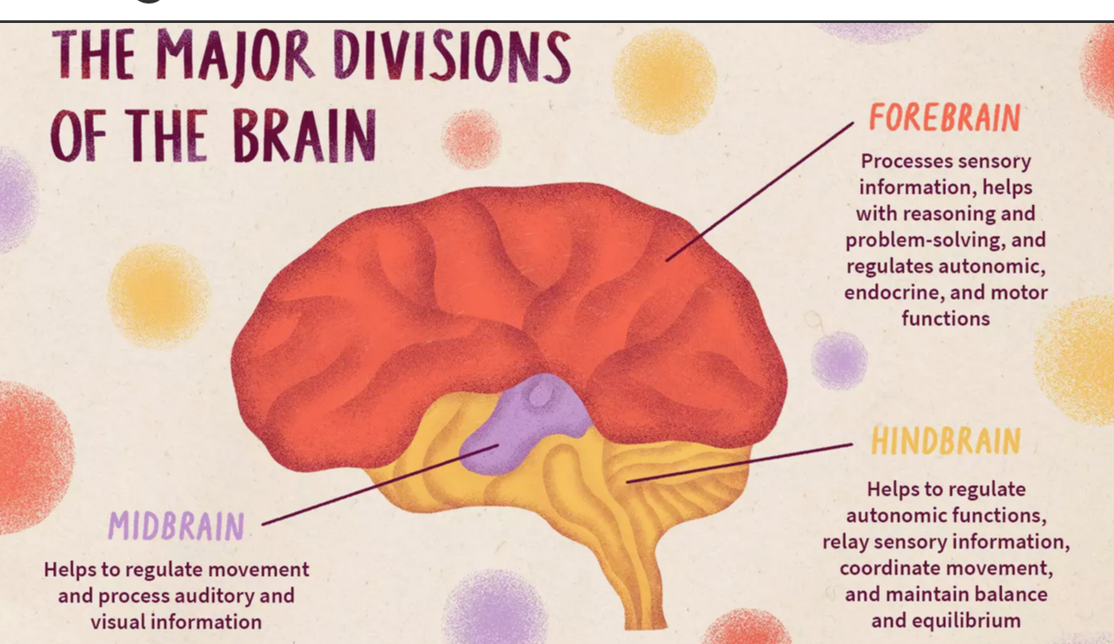
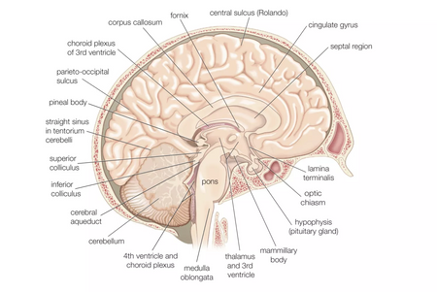
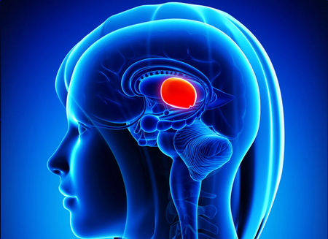
Introduction & Background
Human Brain Taxonomy
Pons
Forebrain
Hindbrain
Midbrain

Slide 6

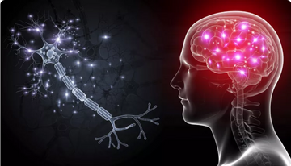
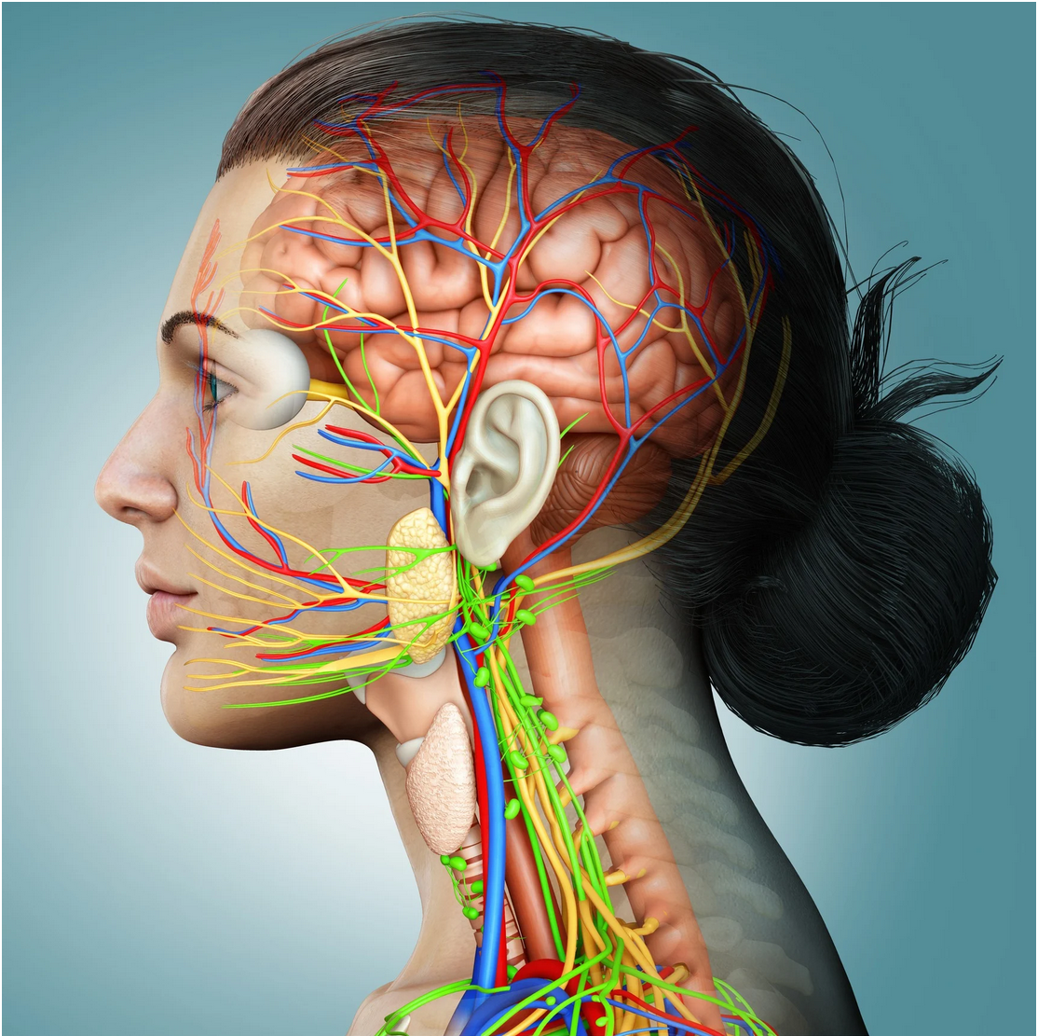
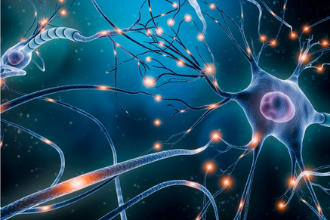
Introduction & Background
Human Brain Physiology
Brain Activities
Communication of Neurons
Brain Functions
Ion Channels

Slide 7
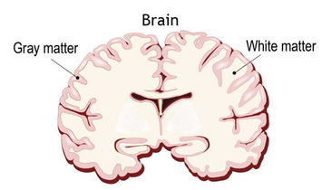
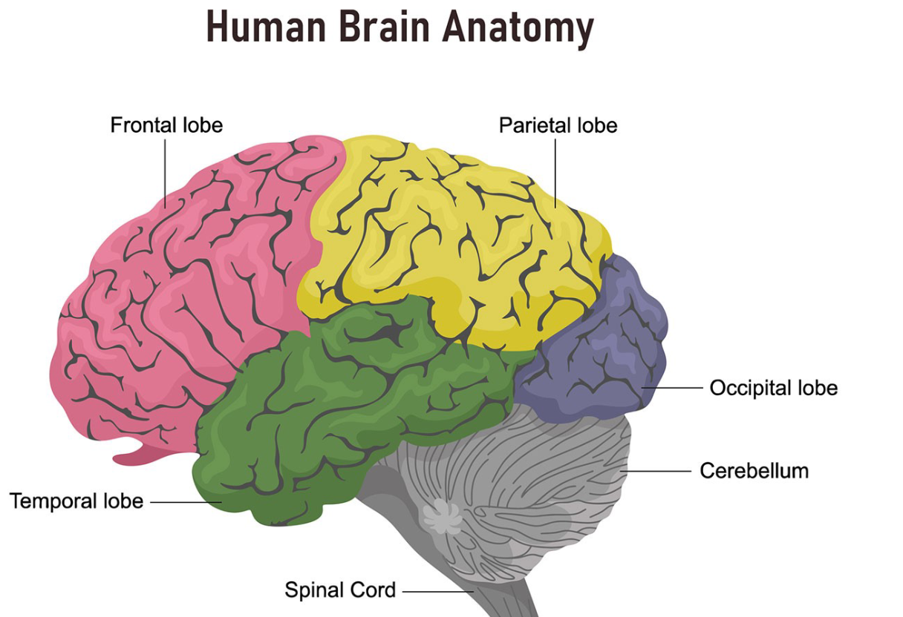
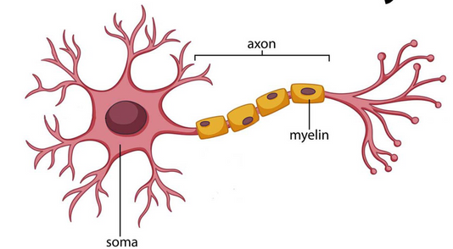
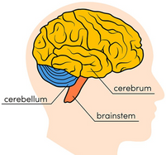
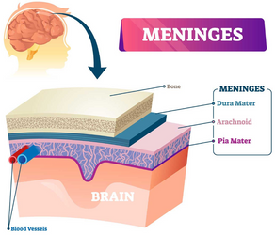
Introduction & Background
White/Gray matter
Neuron
Three main parts of brain
Meninges

Slide 8
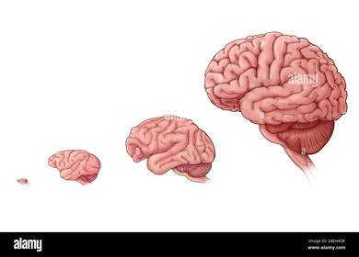
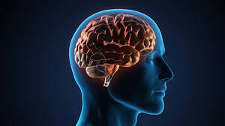

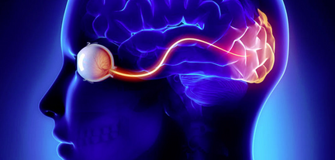
Introduction & Background
Human Brain Morphology
Size
Structure
Relationships between cells
Volume

Slide 9




Problem Statement
Inefficient Learning
Lack of Applications
Frustration

Slide 10


Proposed Solution
3D App
Focus on Aforementioned Perspectives

Slide 11



Objectives
Design and Create 3D system
Deploy it on Android

Slide 12
Literature Review
3D Human Brain
3D app for Android/Windows platform
Visualization of brain using 3D models
Does not contain the description of brain, or its interior organs

Slide 13
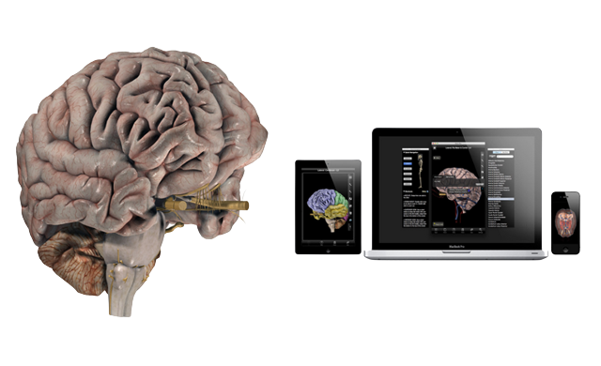
Literature Review
Brain Pro
Mac edition 3D app
Contains wonderful features for the anatomical perspectives of the brain.
Allows sectioned views and custom label
360-degree rotation and slice
View, Edit and Add pins with notes
Layers, Map and Transparency

Slide 14
Literature Review
Brain Pro
Limitations
Does not contain Physiology of brain
Only available for MAC.
Not free

Slide 15
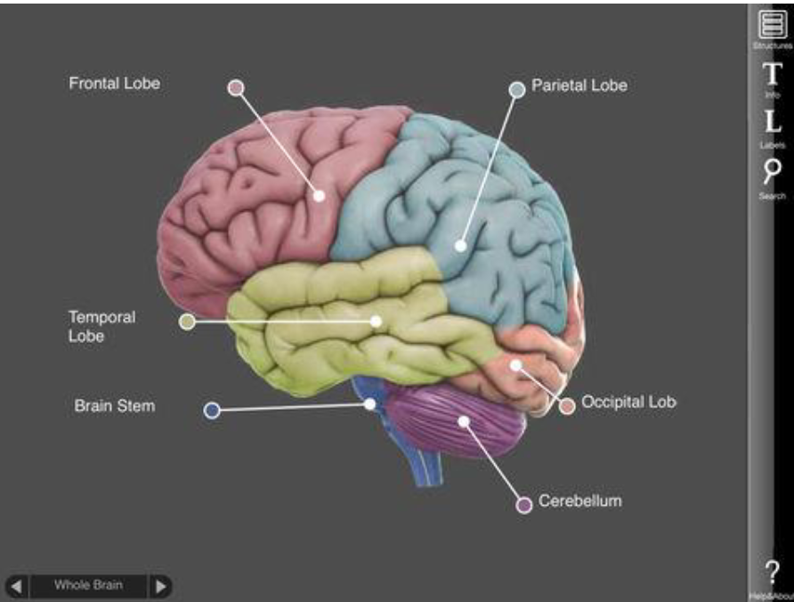
Literature Review
3D Brain
Interactive 3D app for Android devices
Describe anatomy and physiology of the brain.
Freely available
Developed on older versions of Android
May not work in future

Slide 16

Scope of the Project
Focus on the basic introduction of the human brain
Taxonomy, Anatomy, Morphology, and Physiology
Functions of different components of brain

Slide 17
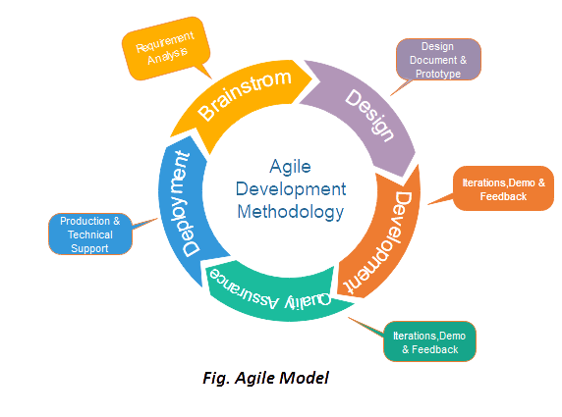
Methodology
Shorter development time
Control over cost and schedule
Accepting changes
Producing high-quality projects.
Agile Model - Extreme Programming (XP)

Slide 18

Methodology
Requirements Analysis
Planning
Design and Development
Integration
System Testing
Deployment

Slide 19



Expected Results
Efficient Learning
Knowledge of Brain
3D visualization

Slide 20
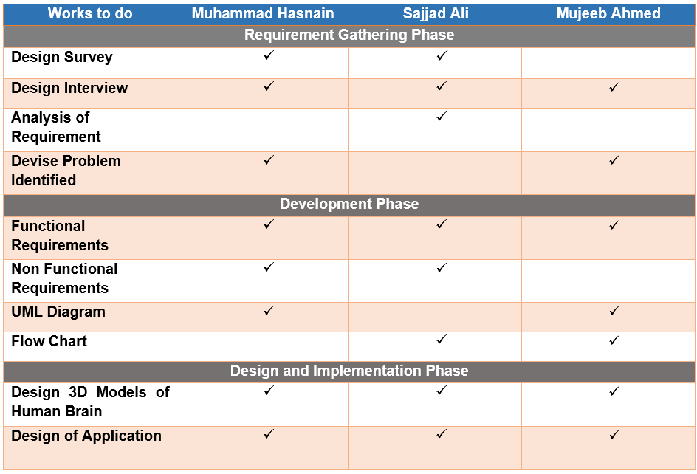
Work Division

Slide 21
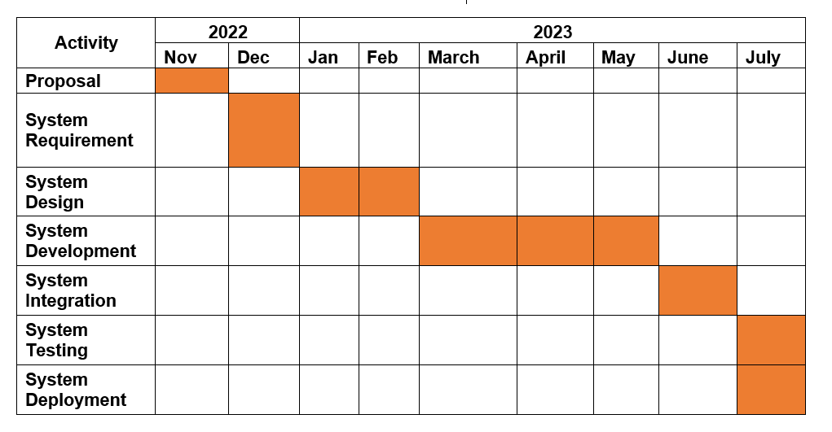
Gantt Chart

Slide 22

Thanks!

